Slide 1
ATTENTION SPAN PREDICTION USING
HEAD-POSE ESTIMATION WITH DEEP
NEURAL NETWORKS
PRESENTED BY
K.BUVANESHVARAN - 811318104003
A.JHEYARAGHAVAN - 811318104006
J.KEVIN ROLAND - 811318104007

Slide 2
BASE PAPER DETAILS
ATTENTION SPAN PREDICTION USING HEAD-POSE
ESTIMATION WITH DEEP NEURAL NETWORKS
BY
Tripti Singh, Mohan Mohadikar, Shilpa Gite, Shruti Patil, Biswajeet Pradhan, And Abdullah Alamri
date of publication October 14, 2021, date of current version October 26, 2021.
DOI : 10.1109/ACCESS.2021.3120098

Slide 3
OBJECTIVE
The objective is design and implementation of automatic alert based system on distance.
The minimum distance from computer to human is 0.38 m (1.2 ft.) and maximum distance from computer to human is1.02 m (3.3 ft.).
It can be achieved by using deep learning technology.
The additional objective is designing a parent children alert system to alert the unwanted website.

Slide 4
INTRODUCTION
Deep learning is a type of machine learning and artificial intelligence (AI) that imitates the way humans gain certain types of knowledge.
Deep learning is an important element of data science, which includes statistics and predictive modelling.

Slide 5
LITERATURE SURVEY
Author | Journal | Paper title | Algorithm | Merits | Demerits
M.Donoser, 2010 | IEEE 12th International Conference | Saliency Driven Total Variation Segmentation | Unsupervised saliency driven segmentation | Allows to provide accuracy | Implemented in limited datasets
2. C. Guo,2010 | IEEE Transactions on Image Processing | A Novel Multi resolution Spatiotemporal Saliency Detection Model and Its Applications in Image and Video Compression | Saliency Tool Box (STB) | Predict the human fixation | Only considers bottom-up information

Slide 6
LITERATURE SURVEY
Author | Journal | Paper title | Algorithm | Merits | Demerits
3. S.Frintrop,2014 | IEEE conference | A Cognitive Approach for Object Discovery | Computational object discovery | Able to detect objects in web images | Object hypotheses invalid
4. L. Itti,1998 | IEEE Transactions on pattern analysis and machine intelligence | A Model of Saliency-Based Visual Attention for Rapid Scene Analysis | Dynamical neural network | Proved efficient approach | Arbitrary tasks are difficult

Slide 7
LITERATURE SURVEY
Author | Journal | Paper title | Algorithm | Merits | Demerits
5. Qiong Yan, 2013 | IEEE conference on computer vision | Hierarchical Saliency Detection | High-response saliency map | Pruning similar nearest neighbors | Not to be feasibility
6. Simone Frintrop,2015 | IEEE Conference on Computer Vision and Pattern Recognition | Traditional Saliency Reloaded: A Good Old Model in New Shape | Difference-of- Gaussians | Analyze local or global surround | Not implement in real time systems

Slide 8
LITERATURE SURVEY
Author | Journal | Paper title | Algorithm | Merits | Demerits
7. Ming-Ming Cheng,2011 | IEEE Transactions on Pattern Analysis and Machine Intelligence | Global Contrast based Salient Region Detection | SaliencyCut | Object detection in cluttered scenes | Requiring expensive training data
8. Peng Jiang,2013 | IEEE international conference on computer vision. | Salient Region Detection by UFO: Uniqueness, Focusness and Objectness | UFO model | Analyze micro-level image features | Objectness estimation is inaccuracy

Slide 9
PROBLEM DEFINITION
All peoples use computers, laptops in many fields now a days. These are very useful to do work easily and quickly. But there are many drawbacks using these Personal computers.
Operate the system only for a limited time as it cause pain in spiral cord, headache and so on.

Slide 10
PROBLEM DEFINITION
When we use a laptop for prolonged periods it cause impact as the distance between the screen of the laptop and the keyboard is very little, the constant staring at the flashing screen will spell sorry-sore to the eye.
To overcome the disadvantage we implement the framework to analyze the human faces and measure distances from monitors using deep learning.

Slide 11
PROPOSED SYSTEM
Assessing vision system for measuring distances based on their inbuilt web camera.
Capture facial images and separate foreground from background.
Draw the bounding box and also to calculate the distance measurement from web camera.

Slide 12
SYSTEM REQUIREMENTS
Hardware Specification
Processor : Intel processor
RAM : 04 GB
Hard disk : 930 GB
Compact Disk : 650 Mb
Keyboard : Standard keyboard
Monitor : 15 inch color monitor

Slide 13
Software Specification
Operating system : Windows OS
Front End :.NET (C#)
Back End : SQL SERVER

Slide 14
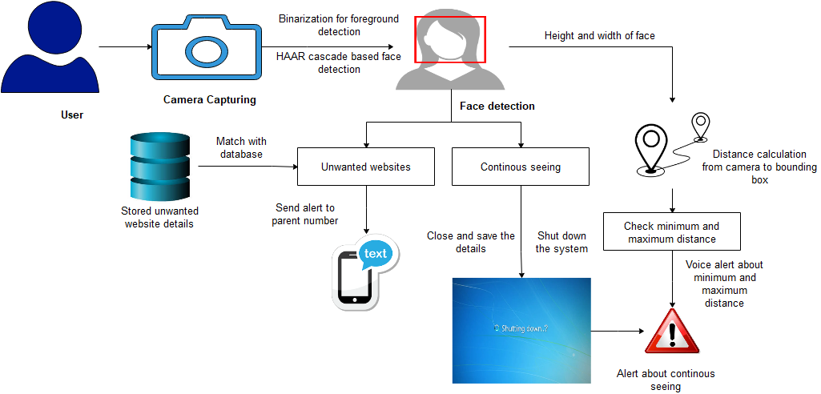
ARCHITECTURE DIAGRAM

Slide 15
MODULES
Image Acquisition
Face Detection Algorithm
Distance Measurement
Alert System
Parental Control

Slide 16
MODULE DESCRIPTION
Image Acquisition:
Implementation of real time capturing of images using web camera.
Using inbuilt or additional web camera for capturing the images.
Web camera additionally run in historical past application and additionally use finalization method to pixel values for each historical past and foreground.
0’s values assigned for returned background, 1’s values assigned for foreground.

Slide 17
MODULE DESCRIPTION
Face Detection Algorithm:
HAAR cascade algorithm is implemented.
Using skin color to predict face color find the Movements of facial parts such as eyes, noses and lips measure the corner points of face images.

Slide 18
ALGORITHM AND TECHNIQUES
STEPS OF HAAR CASCADE ALGORITHM
Pick a pixel location from the image.
Now crop a sub-image with the selected pixel as the center from the source image with the same size as the convolution kernel.
Calculate an element-wise product between the values of the kernel and sub- image and add the result of the image.
Put the resultant value into the new image at the same place where you picked up the pixel location.

Slide 19
CONVOLUTIONAL NEURAL NETWORK
It is a method used in artificial neural networks to calculate a gradient that is needed in the calculation of the weights to be used in the network.
Randomly initialize the weights and biases.
Feed the training sample.
Propagate the inputs forward compute the net input and output of each unit in the hidden and output layers.

Slide 20
CONVOLUTIONAL NEURAL NETWORK
Convolution of the error to the hidden layer.
Update weights and biases to reflect the propagated errors.
Training and learning functions are mathematical procedures used to automatically adjust the network's weights and biases.
Terminating condition.

Slide 21
MODULE DESCRIPTION
Distance Measurements:
Calculate line measurements from web camera through bounding box.
Real time implementation can be used for every face images.
Bounding box values may be vary for every person.

Slide 22
MODULE DESCRIPTION
Alert System:
In this module implementation of voice based alert system.
Set the edge values for distances.
If the distance is less than 1.2 feet means, set voice alert is“ Near to the system” If the distance is greater than 3.3 feet means, set voice alert is “Far from the system”.
Alert the system about constant seeing and also send SMS alert to parents about to see unwanted websites.

Slide 23
MODULE DESCRIPTION
Parental Control:
In this module, we can implement the system to send alert to parent number.
Alert system can be provide the message about Constant seeing, Unwanted website access.

Slide 24
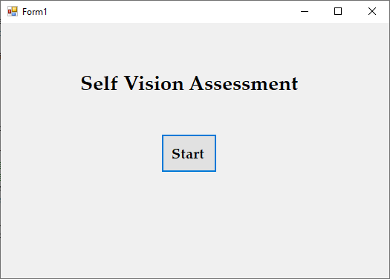
SCREENSHOTS 1

Slide 25
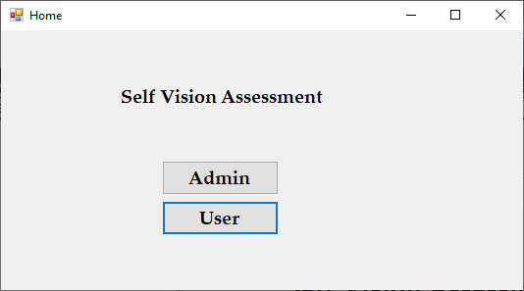
SCREENSHOTS 2

Slide 26
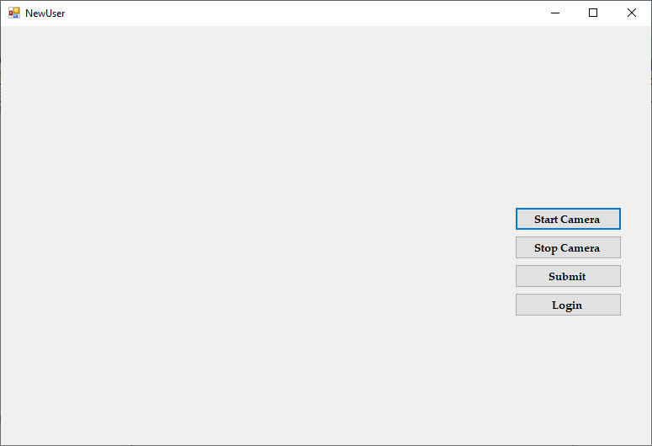
SCREENSHOTS 3

Slide 27
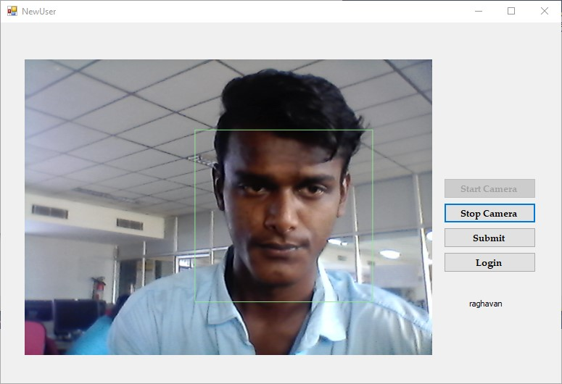
SCREENSHOTS 4

Slide 28
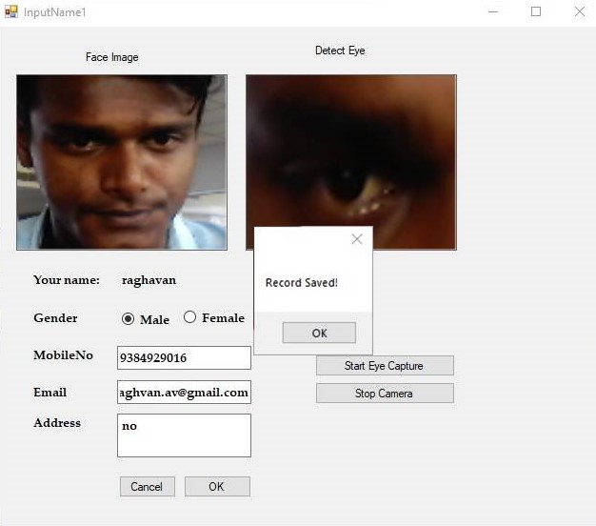
SCREENSHOTS 5

Slide 29
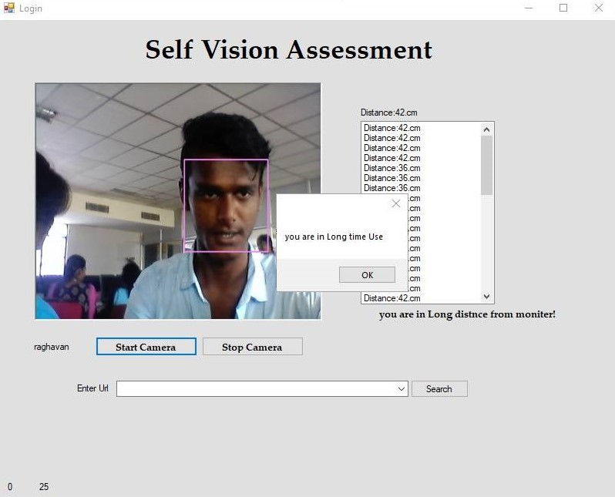
SCREENSHOTS 6

Slide 30
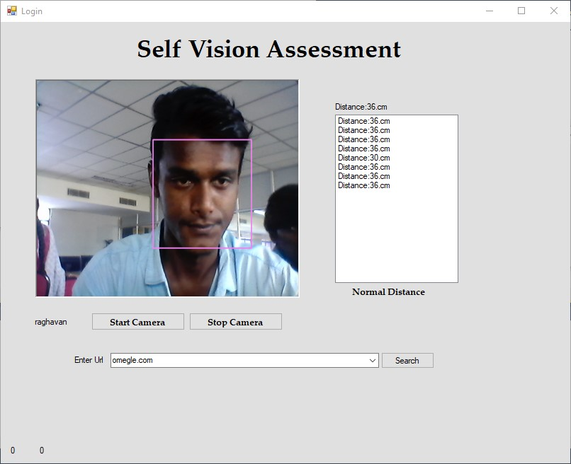
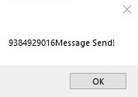


SCREENSHOTS 7

Slide 31

SCREENSHOTS 8

Slide 32
CONCLUSION
It is difficult to set a specific limit for a minimum viewing distance.
If sustained viewing closer than the resting point of vergence contributes to eyestrain, perhaps we must say that eye-display distance should now not be closer than the resting factor of vergence.
In this assignment we may be implemented the gadget to using photo processing techniques to detect the faces from digital camera capturing.
Then successfully music the faces and to provide bounding boxes on face pictures. Finally set the gap limits to discover whether or not the individual is close to the device or not.

Slide 33
REFERENCES
[1] Ruiz, Nataniel, Eunji Chong, and James M. Rehg. "Fine-grained head pose estimation without keypoints." Proceedings of the IEEE conference on computer vision and pattern recognition workshops. 2018.
[2] Meyer, Gregory P., et al. "Robust model-based 3d head pose estimation." Proceedings of the IEEE international conference on computer vision. 2015.
[3] Cao, Zhiwen, et al. "A vector-based representation to enhance head pose estimation." Proceedings of the IEEE/CVF Winter Conference on Applications of Computer Vision. 2021.

Slide 34
REFERENCES
[4] Yang, Tsun-Yi, et al. "Fsa-net: Learning fine-grained structure aggregation for head pose estimation from a single image." Proceedings of the IEEE/CVF Conference on Computer Vision and Pattern Recognition. 2019.
[5] Borghi, Guido, et al. "Face-from-depth for head pose estimation on depth images." IEEE transactions on pattern analysis and machine intelligence 42.3 (2018): 596-609.

Slide 35
THANK YOU

